Slide 1
EE-2003 Computer Organization & Assembly Language
INSTRUCTOR
Engr. Aashir Mahboob
Lecturer, Department of Computer Science
FAST NUCES (Karachi)
Aashir.mahboob@nu.edu.pk

Slide 2
Chapter 9: Strings & Arrays

Slide 3
Strings & Arrays
String Primitive Instructions
Selected String Procedures
Two-Dimensional Arrays
Searching and Sorting Integer Arrays

Slide 4
String Primitive Instructions

Slide 5
String Primitive Instructions
MOVSB, MOVSW, and MOVSD
CMPSB, CMPSW, and CMPSD
SCASB, SCASW, and SCASD
STOSB, STOSW, and STOSD
LODSB, LODSW, and LODSD

Slide 6
MOVSB, MOVSW, & MOVSD
The MOVSB, MOVSW, and MOVSD instructions copy data from the memory location pointed to by ESI to the memory location pointed to by EDI.
Example:
.data
source DWORD 0FFFFFFFFh
target DWORD ?
.code
mov esi, OFFSET source
mov edi, OFFSET target
movsd

Slide 7
MOVSB, MOVSW, & MOVSD
ESI and EDI are automatically incremented or decremented:
MOVSB increments/decrements by 1
MOVSW increments/decrements by 2
MOVSD increments/decrements by 4

Slide 8
Direction Flag
The Direction flag controls the incrementing or decrementing of ESI and EDI.
DF = clear (0): increment ESI and EDI
DF = set (1): decrement ESI and EDI
The Direction flag can be explicitly changed using the CLD and STD instructions:
CLD ; clear Direction flag
STD ; set Direction flag

Slide 9
Using a Repeat Prefix
By itself, a string primitive instruction processes only a single memory value or pair of values.
REP (a repeat prefix) can be inserted just before MOVSB, MOVSW, or MOVSD
ECX controls the number of repetitions
Example: Copy 20 doublewords from source to target
.data
source DWORD 20 DUP(?)
target DWORD 20 DUP(?)
.code
cld ; direction = forward
mov ecx,LENGTHOF source ; set REP counter
mov esi,OFFSET source
mov edi,OFFSET target
rep movsd

Slide 10
Example
Use MOVSD to delete the first element of the following doubleword array. All subsequent array values must be moved one position forward toward the beginning of the array: array DWORD 1,1,2,3,4,5,6,7,8,9,10
Solution:
.data
array DWORD 1,1,2,3,4,5,6,7,8,9,10
.code
cld
mov ecx,(LENGTHOF array) - 1
mov esi,OFFSET array+4
mov edi,OFFSET array
rep movsd

Slide 11
CMPSB, CMPSW, & CMPSD
The CMPSB, CMPSW, and CMPSD instructions each compare a memory operand pointed to by ESI to a memory operand pointed to by EDI
CMPSB compares bytes
CMPSW compares words
CMPSD compares doublewords
Repeat prefix often used
REPE (REPZ)
REPNE (REPNZ)

Slide 12
Comparing a Pair of Doublewords
If source > target, the code jumps to label L1; otherwise, it jumps to label L2
Solution:
.data
source DWORD 1234h
target DWORD 5678h
.code
mov esi, OFFSET source
mov edi, OFFSET target
cmpsd ; compare doublewords
ja L1 ; jump if source > target
jmp L2 ; jump if source <= target

Slide 13
Comparing a Pair of Doublewords
Modify the program in the previous slide by declaring both source and target as WORD variables. Make any other necessary changes.
Solution:

Slide 14
Comparing a Pair of Doublewords
Use a REPE (repeat while equal) prefix to compare corresponding elements of two arrays
Solution:
.data
COUNT = 20
source DWORD COUNT DUP(?)
target DWORD COUNT DUP(?)
.code
mov ecx, COUNT ; repetition count
mov esi, OFFSET source
mov edi, OFFSET target
cld ; direction = forward
repe cmpsd ; repeat while equal

Slide 15
Example: Comparing Two Strings
This program compares two strings (source and destination). It displays a message indicating whether the lexical value of the source string is less than the destination string.
Solution:
.data
source BYTE "MARTIN "
dest BYTE "MARTINEZ"
str1 BYTE "Source is smaller",0dh,0ah,0
str2 BYTE "Source is not smaller",0dh,0ah,0

Slide 16
Example: Comparing Two Strings
.code
main PROC
cld ; direction = forward
mov esi, OFFSET source
mov edi, OFFSET dest
mov ecx, LENGTHOF source
repe cmpsb
jb source_smaller
mov edx,OFFSET str2 ; "source is not smaller"
jmp done
source_smaller:
mov edx,OFFSET str1 ; "source is smaller"
done:
call WriteString
exit
main ENDP
END main

Slide 17
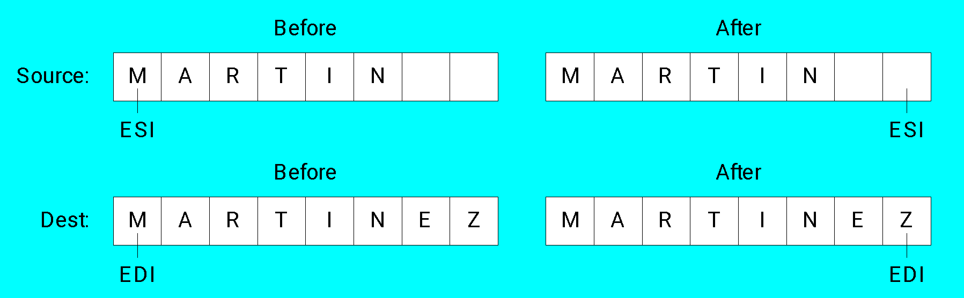
Example: Comparing Two Strings
The following diagram shows the final values of ESI and EDI after comparing the strings:

Slide 18
SCASB, SCASW, & SCASD
The SCASB, SCASW, and SCASD instructions compare a value in AL/AX/EAX to a byte, word, or doubleword, respectively, addressed by EDI
Useful types of searches:
Search for a specific element in a long string or array
Search for the first element that does not match a given value

Slide 19
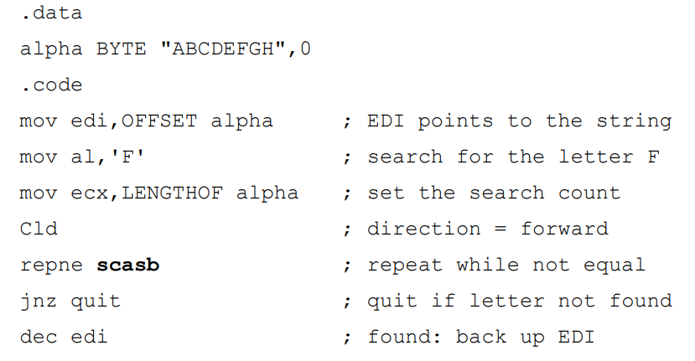
SCASB, SCASW, & SCASD
Search for the letter 'F' in a string named alpha:
Solution:

Slide 20
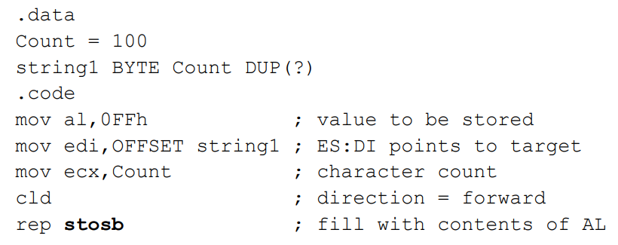
STOSB, STOSW, & STOSD
The STOSB, STOSW, and STOSD instructions store the contents of AL/AX/EAX, respectively, in memory at the offset pointed to by EDI
When used with the REP prefix, these instructions are useful for filling all elements of a string or array with a single value
Example: fill an array with 0FFh

Slide 21
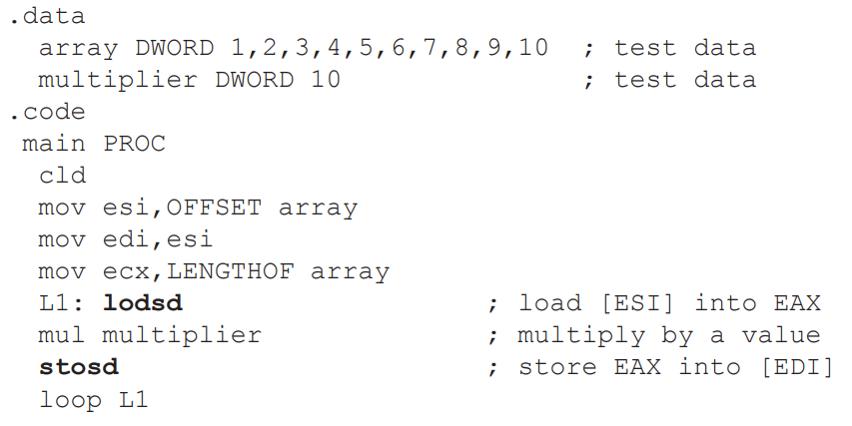
LODSB, LODSW & LODSD
LODSB, LODSW, and LODSD load a byte or word from memory at ESI into AL/AX/EAX, respectively.
•The REP prefix is rarely used with LODS because each new value loaded into the accumulator overwrites its previous contents.
• Instead, LODS is used to load a single value.
Example:

Slide 22
Exercixe
Write a program that converts each unpacked binary-coded decimal byte belonging to an array into an ASCII decimal byte and copies it to a new array.
.data
array BYTE 1,2,3,4,5,6,7,8,9
dest BYTE (LENGTHOF array) DUP(?)
Solution:
.code
mov esi,OFFSET array
mov edi,OFFSET dest
mov ecx,LENGTHOF array
cld ; direction = up
L1: lodsb ; load into AL
or al,30h ; convert to ASCII
stosb ; store into memory
loop L1

Slide 23
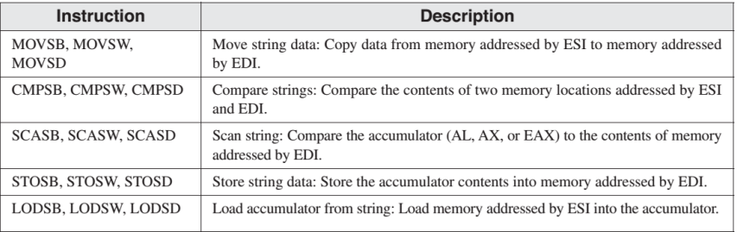
•Although they are called string primitives, they are not limited to character arrays.
•Each instruction implicitly uses ESI, EDI, or both registers to address memory.
•String primitives execute efficiently because they automatically repeat and increment array indexes.

Slide 24
Selected String Procedures

Slide 25
Selected String Procedures
The following string procedures may be found in the Irvine32 and Irvine16 libraries:
Str_compare Procedure
Str_length Procedure
Str_copy Procedure
Str_trim Procedure
Str_ucase Procedure

Slide 26
PROTO DIRECTIVE
•Creates a procedure prototype
label PROTO paramList
•Every procedure called by the INVOKE directive must have a prototype.
•A complete procedure definition can also serve as its own prototype.
•Standard configuration: PROTO appears at top of the program listing, INVOKE appears in the code segment, and the procedure implementation occurs later in the program.

Slide 27
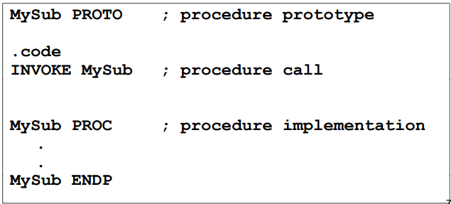
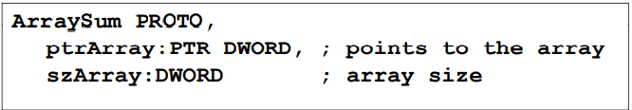
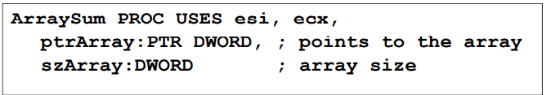
EXAMPLE
• Prototype for the ArraySum procedure, showing its parameter list:

Slide 28
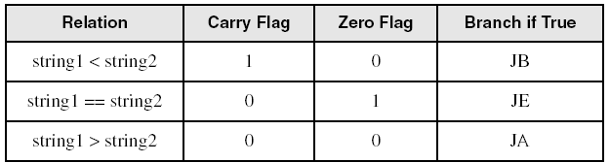
Str_compare Procedure
Compares string1 to string2, setting the Carry and Zero flags accordingly
PROTOTYPE (PROTO):
Str_compare PROTO,
string1:PTR BYTE, ; pointer to string
string2:PTR BYTE ; pointer to string

Slide 29
Str_compare Procedure Source Code
Str_compare PROC USES eax edx esi edi,
string1:PTR BYTE, string2:PTR BYTE
mov esi,string1
mov edi,string2
L1: mov al,[esi]
mov dl,[edi]
cmp al,0 ; end of string1?
jne L2 ; no
cmp dl,0 ; yes: end of string2?
jne L2 ; no
jmp L3 ; yes, exit with ZF = 1
L2: inc esi ; point to next
inc edi
cmp al,dl ; chars equal?
je L1 ; yes: continue loop
L3: ret
Str_compare ENDP

Slide 30
Str_length Procedure
Calculates the length of a null-terminated string and returns the length in the EAX register
PROTOTYPE (PROTO):
Str_length PROTO,
pString:PTR BYTE ; pointer to string
Example:
.data
myString BYTE "abcdefg",0
.code
INVOKE Str_length, ADDR myString ; EAX = 7

Slide 31
Str_length Procedure Source Code
Str_length PROC USES edi,
pString:PTR BYTE ; pointer to string
mov edi, pString
mov eax,0 ; character count
L1:
cmp byte ptr [edi],0 ; end of string?
je L2 ; yes: quit
inc edi ; no: point to next
inc eax ; add 1 to count
jmp L1
L2: ret
Str_length ENDP

Slide 32
Str_copy Procedure
Copies a null-terminated string from a source location to a target location
PROTOTYPE (PROTO):
Str_copy PROTO,
source:PTR BYTE, ; pointer to string
target:PTR BYTE ; pointer to string
Example:
.data
source BYTE "hello",0
target BYTE SIZEOF source DUP (?)
.code
INVOKE Str_copy, ADDR source, ADDR target

Slide 33
Str_copy Procedure Source Code
Str_copy PROC USES eax ecx esi edi,
source:PTR BYTE, ; source string
target:PTR BYTE ; target string
INVOKE Str_length,source ; EAX = length source
mov ecx,eax ; REP count
inc ecx ; add 1 for null byte
mov esi,source
mov edi,target
cld ; direction = up
rep movsb ; copy the string
ret
Str_copy ENDP

Slide 34
Str_trim Procedure
The Str_trim procedure removes all occurrences of a selected trailing character from a null-terminated string
PROTOTYPE (PROTO):
Str_trim PROTO,
pString:PTR BYTE, ; points to string
char:BYTE ; char to remove
Example:
.data
myString BYTE "Hello###",0
.code
INVOKE Str_trim, ADDR myString, '#'
myString = "Hello"

Slide 35
Str_trim Procedure
Str_trim checks a number of possible cases (shown here with # as the trailing character:
The string is empty
The string contains other characters followed by one or more trailing characters, as in "Hello##"
The string contains only one character, the trailing character, as in "#"
The string contains no trailing character, as in "Hello" or "H"
The string contains one or more trailing characters followed by one or more nontrailing characters, as in "#H" or "###Hello"

Slide 36
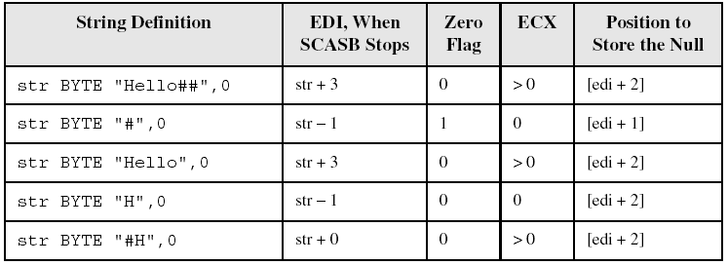
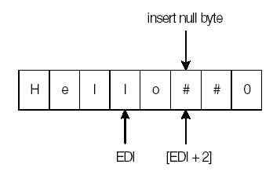
Str_trim Procedure
Using the first definition in the table, position of EDI when SCASB stops:

Slide 37
Str_trim Procedure Source Code
Str_trim PROC USES eax ecx edi,
pString:PTR BYTE, ; points to string
char:BYTE ; char to remove
mov edi,pString
INVOKE Str_length,edi ; returns length in EAX
cmp eax,0 ; zero-length string?
je L2 ; yes: exit
mov ecx,eax ; no: counter = string length
dec eax
add edi,eax ; EDI points to last char
mov al,char ; char to trim
std ; direction = reverse
repe scasb ; skip past trim character
jne L1 ; removed first character?
dec edi ; adjust EDI: ZF=1 && ECX=0
L1: mov BYTE PTR [edi+2],0 ; insert null byte
L2: ret
Str_trim ENDP

Slide 38
Str_ucase Procedure
The Str_ucase procedure converts a string to all uppercase characters. It returns no value.
PROTOTYPE (PROTO):
Str_ucase PROTO,
pString:PTR BYTE ; pointer to string
Example:
.data
myString BYTE "Hello",0
.code
INVOKE Str_ucase, ADDR myString

Slide 39
Str_ucase Procedure Source Code
Str_ucase PROC USES eax esi,
pString:PTR BYTE
mov esi,pString
L1: mov al,[esi] ; get char
cmp al,0 ; end of string?
je L3 ; yes: quit
cmp al,'a’ ; below "a"?
jb L2
cmp al,'z’ ; above "z"?
ja L2
and BYTE PTR [esi],11011111b ; convert the char
L2: inc esi ; next char
jmp L1
L3: ret
Str_ucase ENDP

Slide 40
Two-Dimensional Arrays

Slide 41
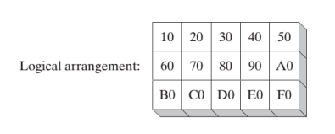


•The two methods of arranging the rows and columns in memory: row-major order and column-major order.
•If you implement a two-dimensional array in assembly language, you can choose either ordering method.

Slide 42
THE TWO OPERAND TYPES
Base-Index Operands
Base-Index Displacement Operands

Slide 43
Base-Index Operand
A base-index operand adds the values of two registers (called base and index), producing an effective address
Any two 32-bit general-purpose registers may be used (Note: esp is not used for general purpose)
[base + index]

Slide 44
Base-Index-Displacement Operand
A base-index-displacement operand combines a displacement, a base register, an index register, and an optional scale factor to produce an effective address.
Displacement can be the name of a variable or a constant expression.
Common Format:
[base + index + displacement]
displacement[base + index]

Slide 45
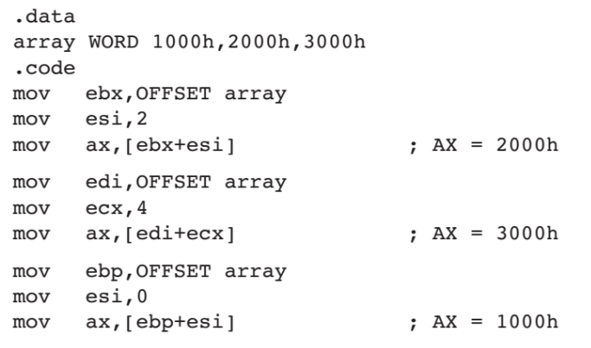
BASE-INDEX OPERANDS

Slide 46
Two-Dimensional Array Example
Imagine a table with three rows and five columns. The data can be arranged in any format on the page:
table BYTE 10h, 20h, 30h, 40h, 50h
BYTE 60h, 70h, 80h, 90h, 0A0h
BYTE 0B0h, 0C0h, 0D0h, 0E0h, 0F0h
NumCols = 5
Alternative format:
table BYTE 10h,20h,30h,40h,50h,60h,70h,80h,90h,0A0h,0B0h,0C0h,0D0h,0E0h,0F0h
NumCols = 5

Slide 47
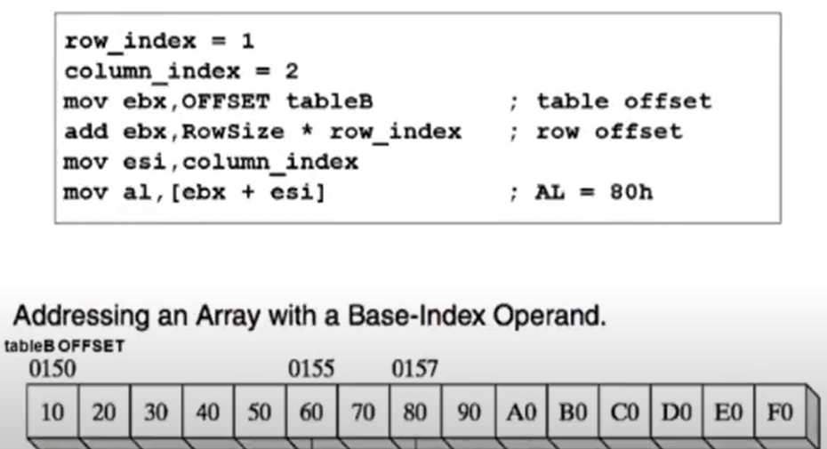
Two-Dimensional Array Example
The following code loads the table element stored in row 1, column 2:

Slide 48
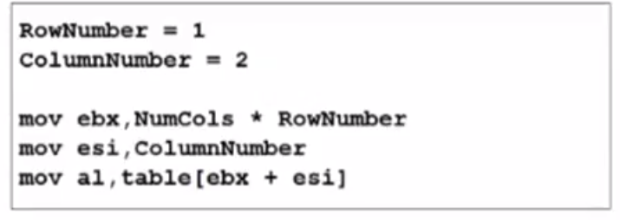
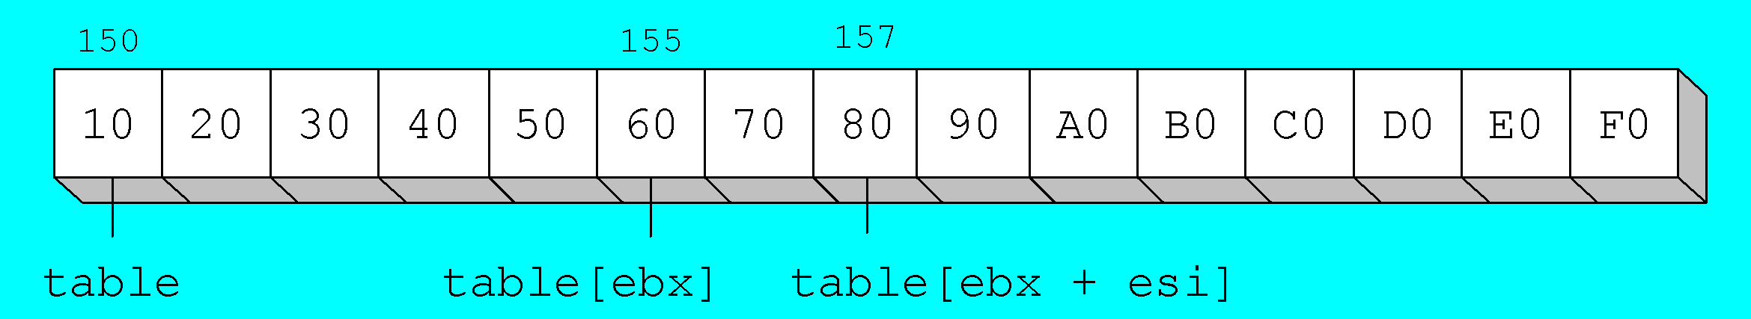
Two-Dimensional Array Example
The following code loads the table element stored in row 1, column 2:

Slide 49
Searching & Sorting Integer Arrays

Slide 50
Searching and Sorting Integer Arrays
Bubble Sort
A simple sorting algorithm that works well for small arrays
Binary Search
A simple searching algorithm that works well for large arrays of values that have been placed in either ascending or descending order

Slide 51
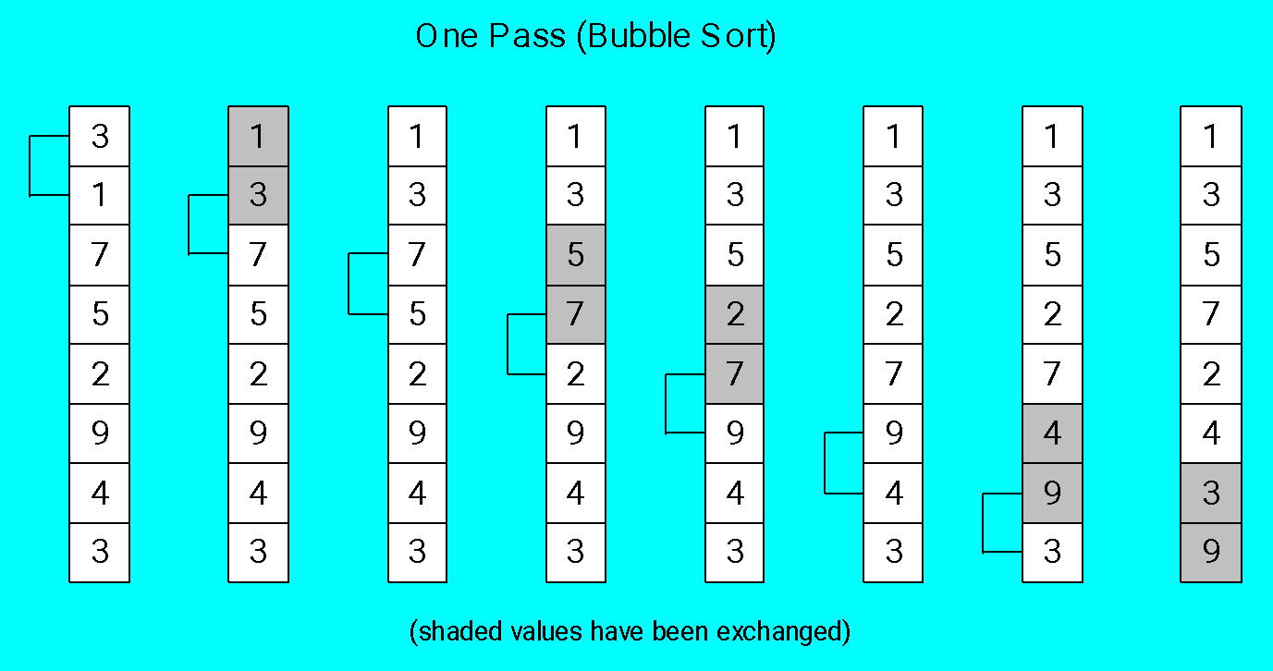
Bubble Sort
Each pair of adjacent values is compared, and exchanged if the values are not ordered correctly:

Slide 52
Bubble Sort Pseudocode
N = array size, cx1 = outer loop counter, cx2 = inner loop counter:
cx1 = N - 1
while( cx1 > 0 )
{
esi = addr(array)
cx2 = cx1
while( cx2 > 0 )
{
if( array[esi] < array[esi+4] )
exchange( array[esi], array[esi+4] )
add esi,4
dec cx2
}
dec cx1
}

Slide 53
Bubble Sort Implementation
BubbleSort PROC USES eax ecx esi,
pArray:PTR DWORD,Count:DWORD
mov ecx,Count
dec ecx ; decrement count by 1
L1: push ecx ; save outer loop count
mov esi,pArray ; point to first value
L2: mov eax,[esi] ; get array value
cmp [esi+4],eax ; compare a pair of values
jge L3 ; if [esi] <= [edi], skip
xchg eax,[esi+4] ; else exchange the pair
mov [esi],eax
L3: add esi,4 ; move both pointers forward
loop L2 ; inner loop
pop ecx ; retrieve outer loop count
loop L1 ; else repeat outer loop
L4: ret
BubbleSort ENDP

Slide 54
Binary Search
Searching algorithm, well-suited to large ordered data sets
Divide and conquer strategy
Each "guess" divides the list in half
Classified as an O(log n) algorithm:
As the number of array elements increases by a factor of n, the average search time increases by a factor of log n

Slide 55
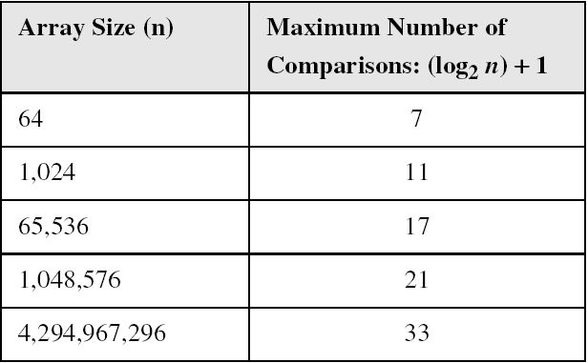
Binary Search

Slide 56
Binary Search Pseudocode
int BinSearch( int values[],
const int searchVal, int count )
{
int first = 0;
int last = count - 1;
while( first <= last )
{
int mid = (last + first) / 2;
if( values[mid] < searchVal )
first = mid + 1;
else if( values[mid] > searchVal )
last = mid - 1;
else
return mid; // success
}
return -1; // not found
}

Slide 57
Binary Search Implementation
BinarySearch PROC uses ebx edx esi edi,
pArray:PTR DWORD, ; pointer to array
Count:DWORD, ; array size
searchVal:DWORD ; search value
LOCAL first:DWORD, ; first position
last:DWORD, ; last position
mid:DWORD ; midpoint
mov first,0 ; first = 0
mov eax,Count ; last = (count - 1)
dec eax
mov last,eax
mov edi,searchVal ; EDI = searchVal
mov ebx,pArray ; EBX points to the array
L1: ; while first <= last
mov eax,first
cmp eax,last
jg L5 ; exit search

Slide 58
Binary Search Implementation (Continue)
; mid = (last + first) / 2
mov eax,last
add eax,first
shr eax,1
mov mid,eax
; EDX = values[mid]
mov esi,mid
shl esi,2 ; scale mid value by 4
mov edx,[ebx+esi] ; EDX = values[mid]
; if ( EDX < searchval(EDI) )
; first = mid + 1;
cmp edx,edi
jge L2
mov eax,mid ; first = mid + 1
inc eax
mov first,eax
jmp L4 ; continue the loop
base-index addressing

Slide 59
Binary Search Implementation (Continue)
; else if( EDX > searchVal(EDI) )
; last = mid - 1;
L2: cmp edx,edi ; (could be removed)
jle L3
mov eax,mid ; last = mid - 1
dec eax
mov last,eax
jmp L4 ; continue the loop
; else return mid
L3: mov eax,mid ; value found
jmp L9 ; return (mid)
L4: jmp L1 ; continue the loop
L5: mov eax,-1 ; search failed
L9: ret
BinarySearch ENDP

Slide 60


